Slide 1


Hope to Skills
Lecture# 22
Irfan Malik, Dr. Sheraz Naseer

Slide 2
Agenda
Limitation of Conventional Models
Neural Networks
Why Neural Networks
Hyper parameters
Learning rate
Epochs
Regularization
Activation functions
Play ground

Slide 3
Previous Lecture:
Lecture 21 - Evaluation Metrics II
Click Here

Slide 4
Quiz
Lecture 22 : Quiz 7
https://forms.gle/r36ueZPTHGFdAHfR7

Slide 5
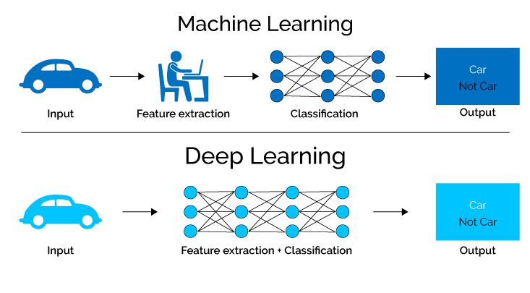
Recap

Slide 6
Shortcoming of Conventional ML
Can NOT directly work with unstructured, high dimensional data (Required Feature Engineering)
Example: Image and Video Data , Genes Data
Can learn only so much from available data (i.e performance does not increase after certain threshold even if more training data is available)

Slide 7
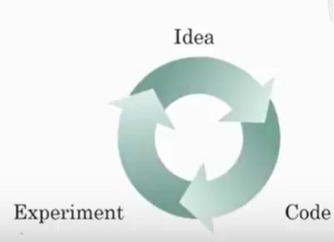
Why is Deep Learning Popular now ?
Most of the techniques used in deep learning are as old as 70 years, then why it is suddenly gaining so much traction ?
Data
Compute
Algorithm

Slide 8
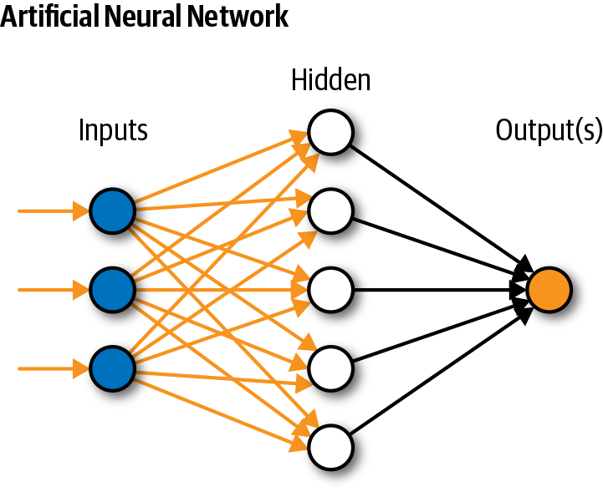
Simple Neural Network

Slide 9
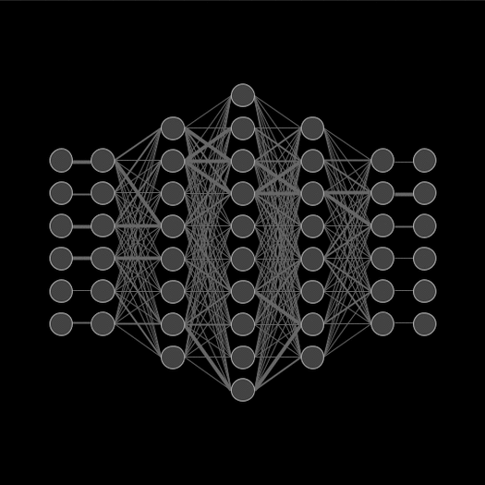
Neural Network

Slide 10

Types of Neural Network

Slide 11
Types of Neural Network

Slide 12

Types of Neural Network

Slide 13
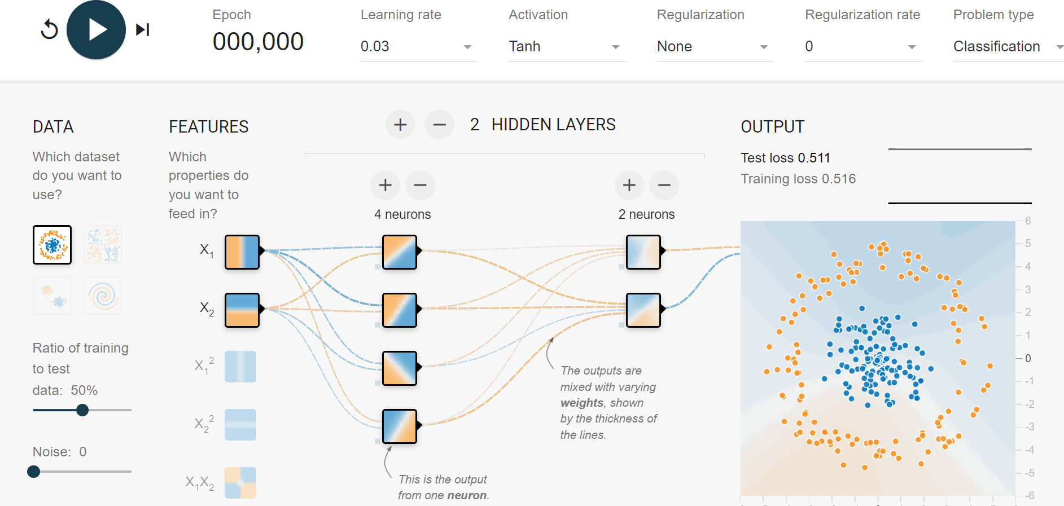
Hyper-parameters

Slide 14
Learning Rate
A hyperparameter that controls the step size during gradient descent optimization. It determines how quickly the model adjusts its parameters in the direction that reduces the loss.
A higher learning rate might lead to faster convergence but risks overshooting, while a lower rate might slow down convergence.

Slide 15
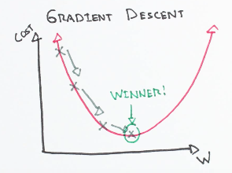
Gradient Descent

Slide 16
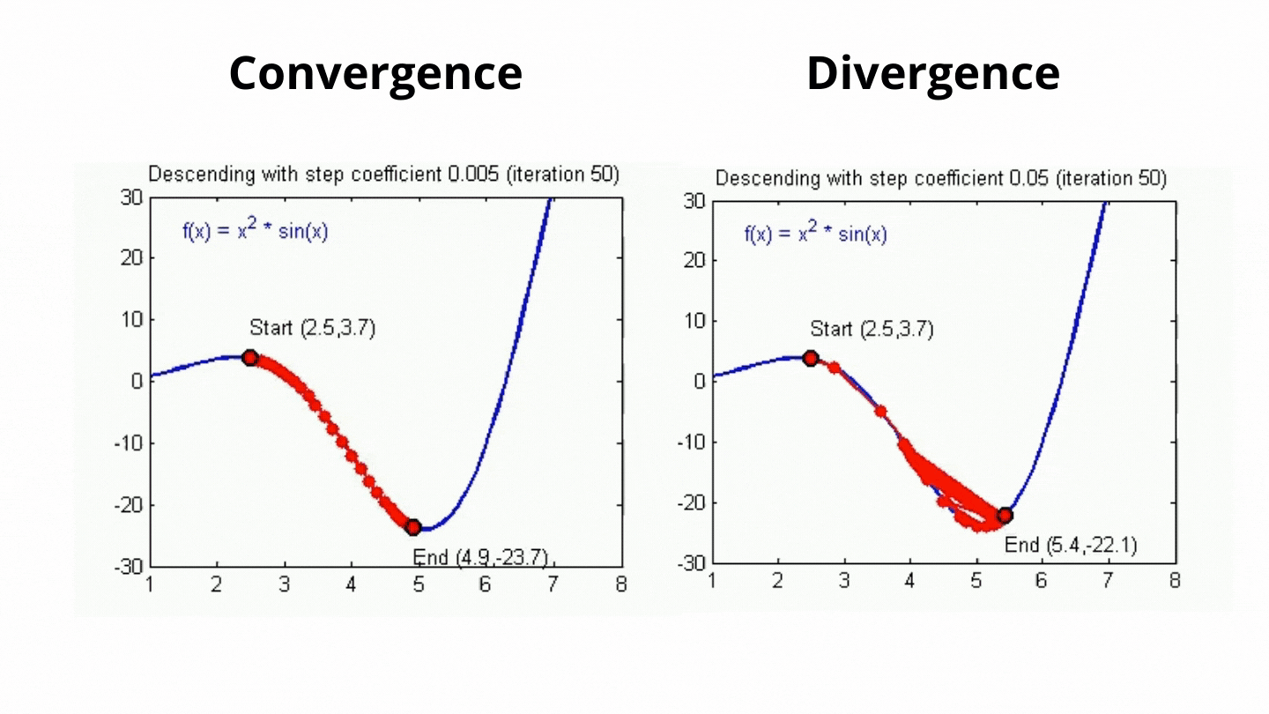

Slide 17

Learning Rate
A higher learning rate might lead to faster convergence but risks overshooting, while a lower rate might slow down convergence.

Slide 18
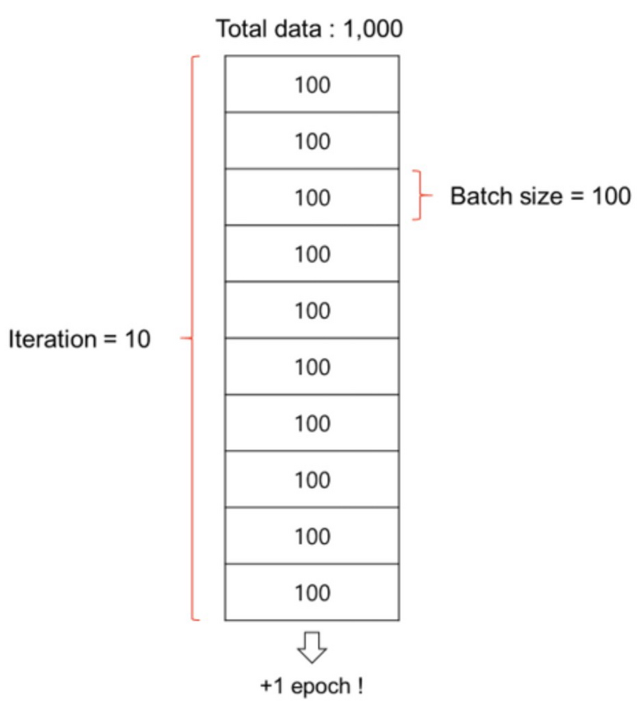
Batch Size
Batch is a subset of the training dataset used in each iteration of the training process.
Instead of processing the entire dataset
at once, we divide it into smaller batches.

Slide 19
Batch Size
Batch size is the number of training examples in each batch.
It's a hyperparameter that can be adjusted based on hardware limitations and dataset characteristics.
Larger batch sizes may speed up training but require more memory.

Slide 20
Number of Epochs
The number of times the entire training dataset is seen by the model during training.
Too few epochs might result in underfitting, while too many epochs can lead to overfitting.

Slide 21
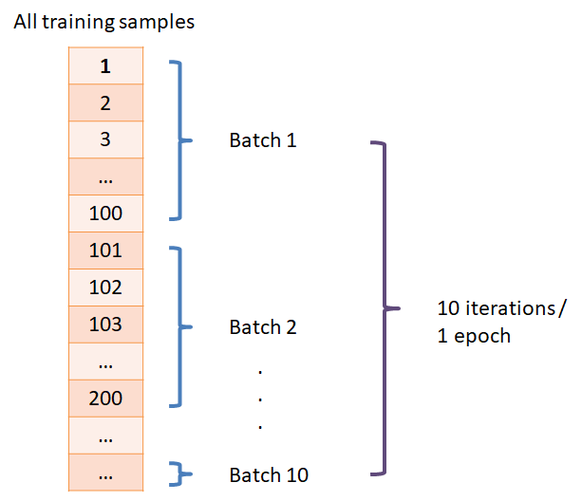
Number of Epochs

Slide 22
Activation Functions (Neuron)
It determine the functions applied to the outputs of each neuron to introduce non-linearity.
Common activation functions include
ReLU (Rectified Linear Unit),
Softmax

Slide 23
Let Move to Playground

Slide 24
Next Lecture:
Basics of Deep Learning
Click Here

